Slide 1







Enterprise Blockchain Developers (Intermediate)
In support of
Powered By

Slide 2
Outline
Create a React App
© 2017-2020 SmartMesh Foundation Pte. Ltd. | MeshBox Foundation Pte. Ltd.

Slide 3
What is Node.js?
Node.js is a server-side platform built on Google Chrome's JavaScript Engine (V8 Engine).
What is a server side framework?
Web browsers communicate with web servers using the HyperText Transfer Protocol (HTTP). When you click a link on a web page, submit a form, or run a search, an HTTP request is sent from your browser to the target server.
Browers/IOS/Android
Server

Slide 4
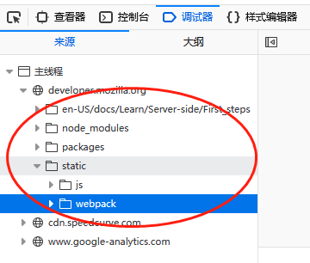
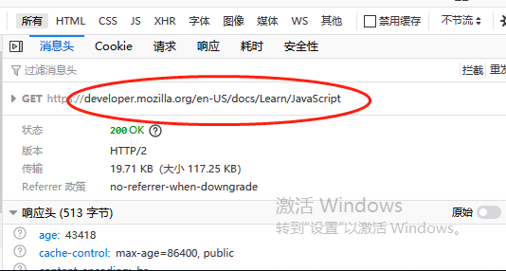
What is Node.js?
Frontend: Dowloaded in your brower
Backend/Server Side: Applications deployed in the server, handling request and data query

Slide 5
Code Demo
var http = require('http');
http.createServer(function (req, res) {
res.writeHead(200, {'Content-Type': 'text/html'});
res.end('Hello World!');
}).listen(8080);
show chrome server and brower response

Slide 6
What is Express
What is Express.js
Express is a fast, assertive, essential and moderate web framework of Node.js. You can assume express as a layer built on the top of the Node.js that helps manage a server and routes. It provides a robust set of features to develop web and mobile applications.
Let's see some of the core features of Express framework:
It can be used to design single-page, multi-page and hybrid web applications.
It allows to setup middlewares to respond to HTTP Requests.
It defines a routing table which is used to perform different actions based on HTTP method and URL.
It allows to dynamically render HTML Pages based on passing arguments to templates.

Slide 7
Code Demo
var express = require('express');
var app = express();
app.get('/', function(req, res){
res.send("Hello world!");
});
app.listen(3000);

Slide 8
MVC
The MVC pattern, in a nutshell, is this:
The model represents the data, and does nothing else. The model does NOT depend on the controller or the view.
The view displays the model data, and sends user actions (e.g. button clicks) to the controller. The view can:
be independent of both the model and the controller; or
actually be the controller, and therefore depend on the model.
The controller provides model data to the view, and interprets user actions such as button clicks. The controller depends on the view and the model. In some cases, the controller and the view are the same object.

Slide 9
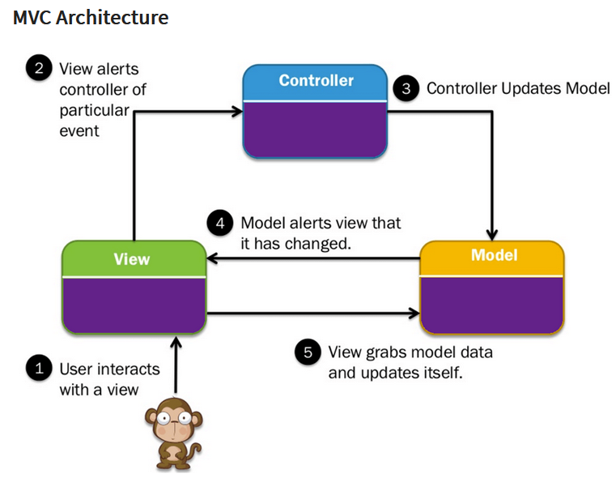
MVC

Slide 10
MVC Code Demo

Slide 11
Architeture Explanation
Membership services: This module is essentially a permissioning module and acts as a vehicle to establish a root of trust during network creation, but this is also instrumental in ensuring and managing the identity of members. Membership services are essentially a certificate authority as well as utilized elements of the public key infrastructure (PKI) for things such as key distribution, management, and establishing federated trust as the network grows. The membership services module provides a specialized digital certificate authority for issuing certificates to members of the blockchain network, and it leverages cryptographic functions provided by Hyperledger Fabric.
Transactions: A transaction is a request to the blockchain to execute a function on the ledger. The function is implemented by a chaincode. Cryptography ensures integrity of transactions by linking the transaction to previous blocks and ensuring the transactional integrity, if protected, by linking the cryptogram or hash from previously linked blocks. Each channel in Hyperledger Fabric is its own blockchain.

Slide 12
Architeture Explanation
Smart contract or chaincode services: Chaincode is an application-level code stored on the ledger as a part of a transaction. Chaincode runs transactions that may modify the world state. Transaction logic is written as chaincode (in the Go or JavaScript languages), and executes in secure Docker containers. The transaction transforms data, scoped by chaincode on the channel from which it operates.
Events: The process of validating peers and chaincodes can produce events (pre-defined events and custom events generated by chaincode) on the network that applications may listen for and take actions on. These events are consumed by event adapters, which may further deliver events using vehicles such as WebHooks or Kafka. Fabric-committing peers provide an event stream to publish events to registered listeners. As of v1.0, the only events that get published are Block events. A Block event gets published whenever the committing peer adds a validated block to the ledger:

Slide 13
Architeture Explanation
Consensus: Consensus is at the heart of any blockchain system. It also enables a trust system. In general, the consensus service enables digitally signed transactions to be proposed and validated by network members. In Hyperledger Fabric, the consensus is pluggable and tightly linked to the endorse-order-validation model that Hyperledger proposes. The ordering services in Hyperledger Fabric represent the consensus system. The ordering service batches multiple transactions into blocks and outputs a hash-chained sequence of blocks containing transactions.
Ledger: Another component is a distributed encrypted ledger, including an append-only data store. This provides the ability to query and write data across distributed ledgers. There are two options: Level DB (default embedded KV DB) supports keyed queries, composite key queries, and key range queries Couch DB (external option) supports keyed queries, composite key queries, key range queries, plus full data rich queries

Slide 14
Architeture Explanation
Client SDK: A client SDK enables the creation of applications that deploy and invoke transactions atop a shared ledger. The Hyperledger Fabric Reference Architecture supports both Node.js and Java SDK. A software developer kit is like a programming kit or set of tools that provide developers with the environment of libraries to write and test chaincode applications. SDKs are critical in blockchain application development and will be discussed in detail in further chapters. Specific capabilities included in the SDK are the application client, chaincode, users, events, and crypto suite.

Slide 15
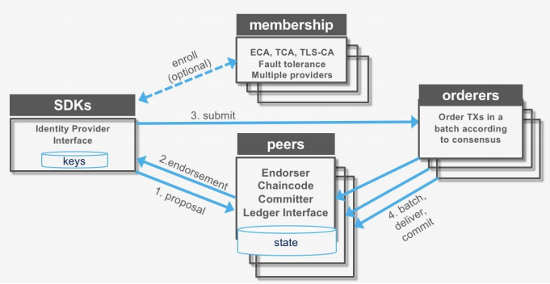
The Transaction Process

Slide 16
Process Explanation
Transaction proposal (application SDK): 1. Transaction proposal is submitted by application SDK 2. It receives a transaction proposal response back (includes ReadWrite set) post endorsement 3. It submits the transaction (includes ReadWrite set) to the ordering service
Transaction endorsement: 1. The transaction is sent to the counter-parties represented by endorsing peers on their channel 2. Each peer executes the transaction by calling the specified chaincode function and signs the result, which becomes the read-write-set of the transaction 3. Each peer may participate in multiple channels, allowing concurrent execution
Transaction submitted to the ordering service: 1. The ordering service accepts endorsed transactions and orders them according to the plug-in consensus algorithm, and then delivers them on the channel 2. Peers on the channel receive transactions and validate before committing to the ledger
Transaction validation: 1. Validates each transaction and commit block 2. Validates the endorsement policy 3. Validates ReadSet versions in state DB 4. Commits the block to blockchain 5. Commits the valid transaction to state DB

Slide 17
WS-5 Lecture Inclusive KYC and Certificates Inclusive Education
06 July 2020

Slide 18
Homework Results (Mentimeter)

